Slide 1

Chapter 8
Big Data Analytics
in the Cloud
Book website: www.hands-on-books-series.com

Slide 2
Outline
What is Analytics?
What is Big Data?
Characteristics of Big Data
Domain Specific Examples of Big Data
Analytics Flow for Big Data
Big Data Stack
Mapping Analytics Flow to Big Data Stack
Analytics Patterns

Slide 3
What is Analytics?
Analytics is a broad term that encompasses the processes, technologies, frameworks and algorithms to extract meaningful insights from data.
Raw data in itself does not have a meaning until it is contextualized and processed into useful information.
Analytics is this process of extracting and creating information from raw data by ﬁltering, processing, categorizing, condensing and contextualizing the data.
This information obtained is then organized and structured to infer knowledge about the system and/or its users, its environment, and its operations and progress towards its objectives, thus making the systems smarter and more efficient.

Slide 4
The Seven Giants
The National Research Council has done a characterization of computational tasks for massive data analysis (called the seven “giants").
These computational tasks include:
(1) Basis Statistics,
(2) Generalized N-Body Problems,
(3) Linear Algebraic Computations,
(4) Graph-Theoretic Computations,
(5) Optimization,
(6) Integration and
(7) Alignment Problems.
This characterization of computational tasks aims to provide a taxonomy of tasks that have proved to be useful in data analysis and grouping them roughly according to mathematical structure and computational strategy.

Slide 5
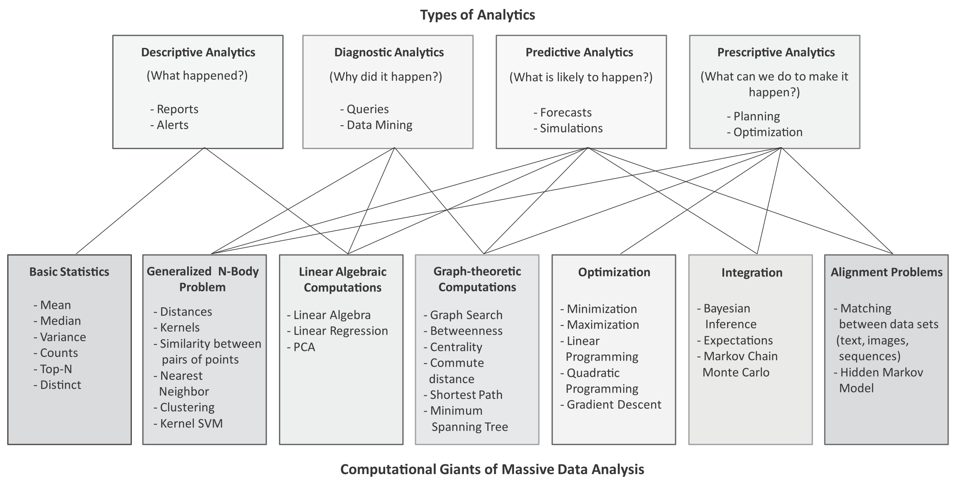
Mapping between types of analytics and computational tasks or ‘giants’

Slide 6
Types of Analytics
Descriptive Analytics
Descriptive analytics comprises analyzing past data to present it in a summarized form which can be easily interpreted. Descriptive analytics aims to answer - What has happened? A major portion of analytics done today is descriptive analytics through use of statistics functions such as counts, maximum, minimum, mean, top-N, percentage, for instance. These statistics help in describing patterns in the data and present the data in a summarized form.
Diagnostic Analytics
Diagnostic analytics comprises analysis of past data to diagnose the reasons as to why certain events happened. Diagnostic analytics aims to answer - Why did it happen? While descriptive analytics can be useful for summarizing the data by computing various statistics (such as mean, minimum, maximum, variance, or top-N), diagnostic analytics can provide more insights into why certain a fault has occurred based on the patterns in the sensor data for previous faults.

Slide 7
Types of Analytics
Predictive Analytics
Predictive analytics comprises predicting the occurrence of an event or the likely outcome of an event or forecasting the future values using prediction models. Predictive analytics aims to answer - What is likely to happen? Predictive Analytics is done using predictive models which are trained by existing data. These models learn patterns and trends from the existing data and predict the occurrence of an event or the likely outcome of an event (classiﬁcation models) or forecast numbers (regression models).
Prescriptive Analytics
While predictive analytics uses prediction models to predict the likely outcome of an event, prescriptive analytics uses multiple prediction models to predict various outcomes and the best course of action for each outcome. Prescriptive analytics aims to answer - What can we do to make it happen? Prescriptive Analytics can predict the possible outcomes based on the current choice of actions.

Slide 8
What is Big Data?
Big data is deﬁned as collections of datasets whose volume, velocity or variety is so large that it is difﬁcult to store, manage, process and analyze the data using traditional databases and data processing tools.
According to an estimate by IBM, 2.5 quintillion bytes of data is created every day.
A recent report by DOMO estimates the amount of data generated every minute on popular online platforms. Below are some key pieces of data from the report:
Facebook users share nearly 4.16 million pieces of content
Twitter users send nearly 300,000 tweets
Instagram users like nearly 1.73 million photos
YouTube users upload 300 hours of new video content
Apple users download nearly 51,000 apps
Skype users make nearly 110,000 new calls
Amazon receives 4300 new visitors
Uber passengers take 694 rides
Netﬂix subscribers stream nearly 77,000 hours of video

Slide 9
Big Data Analytics
Big Data analytics deals with collection, storage, processing and analysis of this massive-scale data.
Big data analytics involves several steps starting from data cleansing, data munging (or wrangling), data processing and visualization.
Specialized tools and frameworks are required for big data analysis when:
the volume of data involved is so large that it is difﬁcult to store, process and analyze data on a single machine,
the velocity of data is very high and the data needs to be analyzed in real-time,
there is variety of data involved, which can be structured, unstructured or semi-structured, and is collected from multiple data sources,
various types of analytics need to be performed to extract value from the data such as descriptive, diagnostic, predictive and prescriptive analytics.

Slide 10
Big Data Examples
Data generated by social networks including text, images, audio and video data
Click-stream data generated by web applications such as e-Commerce to analyze user behavior
Machine sensor data collected from sensors embedded in industrial and energy systems for monitoring their health and detecting failures
Healthcare data collected in electronic health record (EHR) systems
Logs generated by web applications
Stock markets data
Transactional data generated by banking and ﬁnancial applications

Slide 11
Characteristics of Big Data
Volume
Big data is a form of data whose volume is so large that it would not ﬁt on a single machine therefore specialized tools and frameworks are required to store process and analyze such data.
Velocity
Velocity of data refers to how fast the data is generated. Data generated by certain sources can arrive at very high velocities, for example, social media data or sensor data.
Variety
Variety refers to the forms of the data. Big data comes in different forms such as structured, unstructured or semi-structured, including text data, image, audio, video and sensor data.

Slide 12
Characteristics of Big Data
Veracity
Veracity refers to how accurate is the data. To extract value from the data, the data needs to be cleaned to remove noise.
Value
Value of data refers to the usefulness of data for the intended purpose. The end goal of any big data analytics system is to extract value from the data.

Slide 13
Domain Speciﬁc Examples of Big Data
Web
Financial
Healthcare
Internet of Things
Environment
Logistics & Transportation
Industry
Retail

Slide 14
Analytics Flow for Big Data
Data Collection
Data collection is the ﬁrst step for any analytics application. Before the data can be analyzed, the data must be collected and ingested into a big data stack. The choice of tools and frameworks for data collection depends on the source of data and the type of data being ingested.
Data Preparation
Data can often be dirty and can have various issues that must be resolved before the data can be processed, such as corrupt records, missing values, duplicates, inconsistent abbreviations, inconsistent units, typos, incorrect spellings and incorrect formatting. Data preparation step involves various tasks such as data cleansing, data wrangling or munging, de-duplication, normalization, sampling and ﬁltering.

Slide 15
Analytics Flow for Big Data
Analysis Types
The next step in the analysis ﬂow is to determine the analysis type for the application.
Analysis Modes
With the analysis types selected for an application, the next step is to determine the analysis mode, which can be either batch, real-time or interactive. The choice of the mode depends on the requirements of the application.
Visualizations
The choice of the visualization tools, serving databases and web frameworks is driven by the requirements of the application. Visualizations can be static, dynamic or interactive.

Slide 16
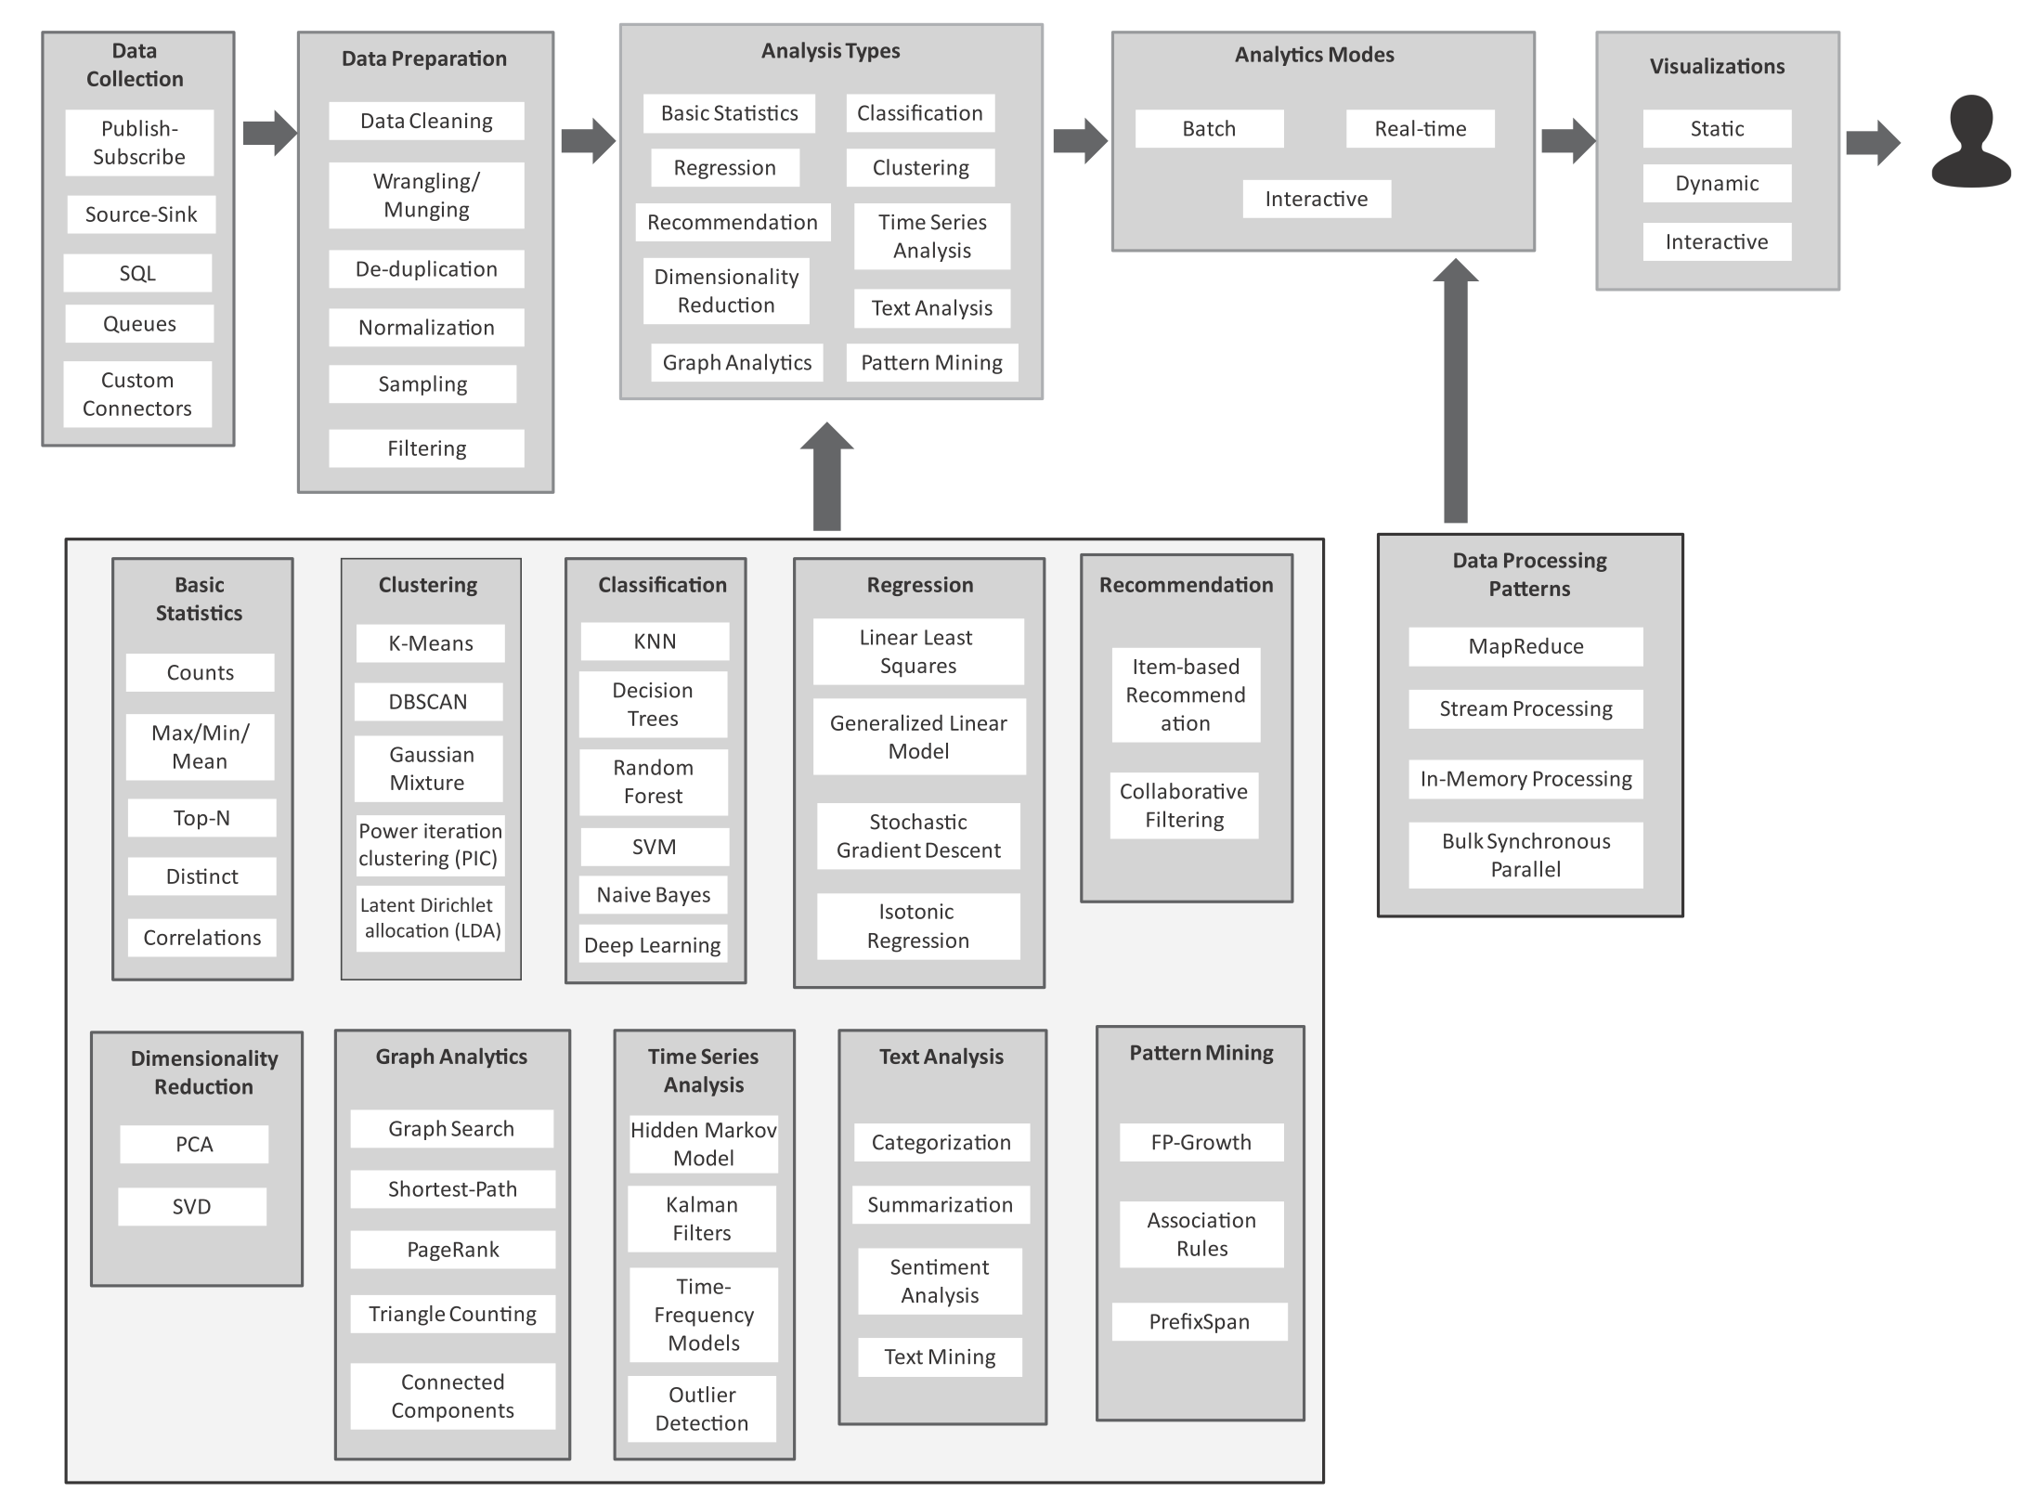
Analytics Flow for Big Data

Slide 17
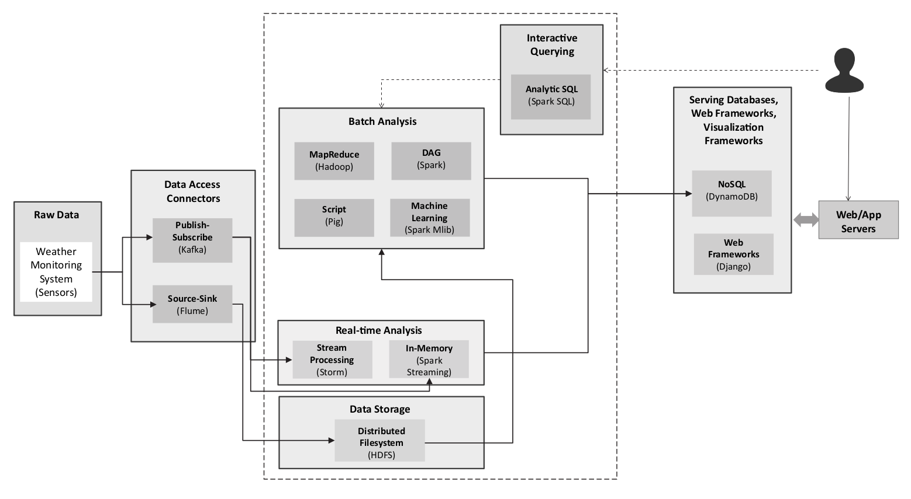
Big Data Stack

Slide 18
Big Data Stack
Raw Data Sources
In any big data analytics application or platform, before the data is processed and analyzed, it must be captured from the raw data sources into the big data systems and frameworks.
Data Access Connectors
The Data Access Connectors includes tools and frameworks for collecting and ingesting data from various sources into the big data storage and analytics frameworks. The choice of the data connector is driven by the type of the data source.
Data Storage
The data storage block in the big data stack includes distributed ﬁlesystems and non-relational (NoSQL) databases, which store the data collected from the raw data sources using the data access connectors.

Slide 19
Big Data Stack
Batch Analytics
The batch analytics block in the big data stack includes various frameworks which allow analysis of data in batches such as Hadoop-MapReduce, Pig, Oozie, Pig, Spark, Solr.
Real-time Analytics
The real-time analytics block includes the Apache Storm and Spark Streaming frameworks.
Interactive Querying
Interactive querying systems allow users to query data by writing statements in SQL-like languages.
Serving Databases, Web & Visualization Frameworks
While the various analytics blocks process and analyze the data, the results are stored in serving databases for subsequent tasks of presentation and visualization. These serving databases allow the analyzed data to be queried and presented in the web applications.

Slide 20
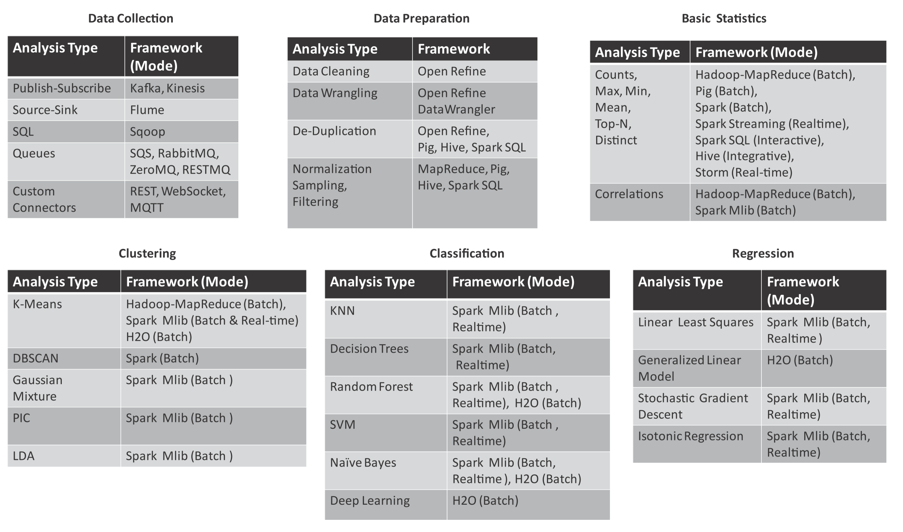
Mapping Analytics Flow to Big Data Stack

Slide 21
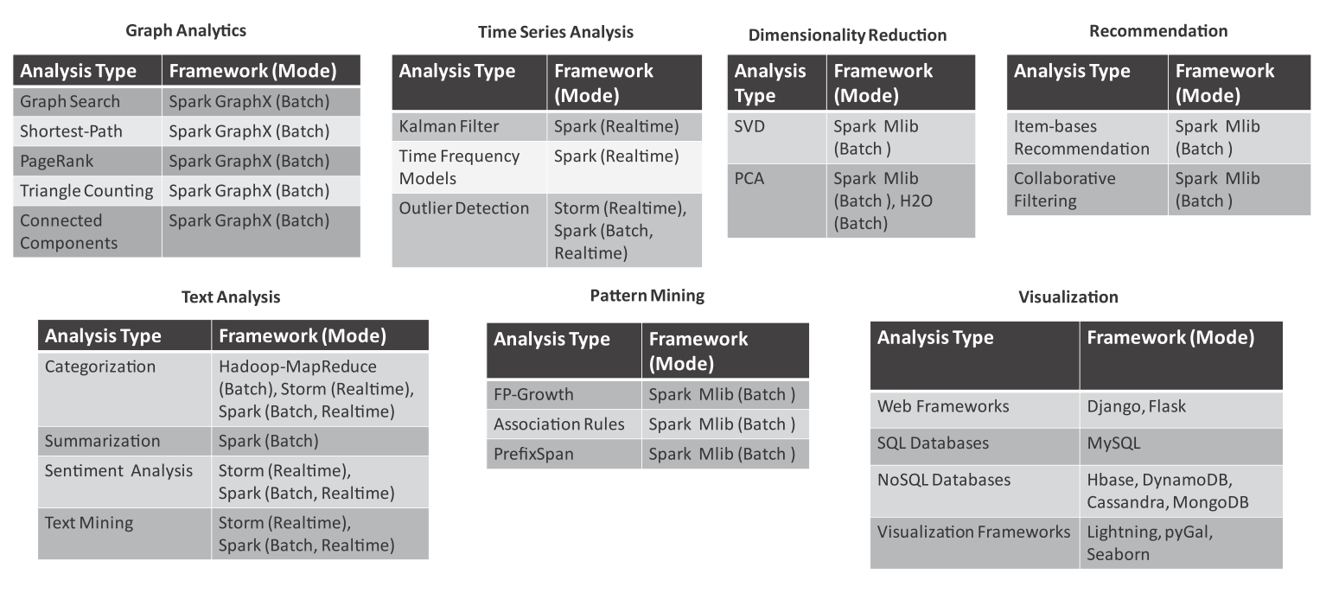
Mapping Analytics Flow to Big Data Stack

Slide 22
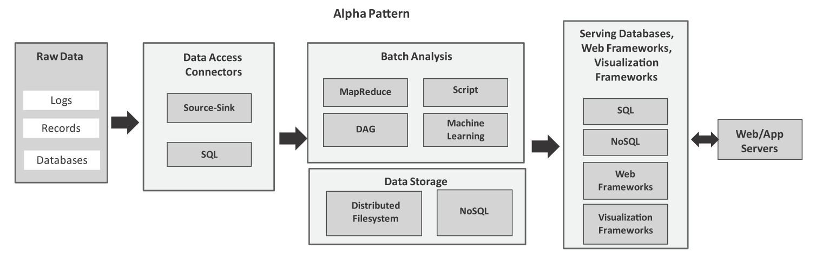
Analytics Patterns
Alpha Pattern
This pattern can be used for ingesting large volumes of data into a distributed ﬁlesystem (such as HDFS) or a NoSQL database (such as HBase) using source-sink connectors (such as Flume) and SQL connectors (such as Sqoop). After the data is moved to the stack, the data can be analyzed in batch mode with batch analysis frameworks including MapReduce (using Hadoop), scripting frameworks (such as Pig), distributed acyclic graph frameworks (such as Spark), machine learning frameworks (such as Spark MLlib). The analysis results are stored either in relational or non-relational databases.

Slide 23
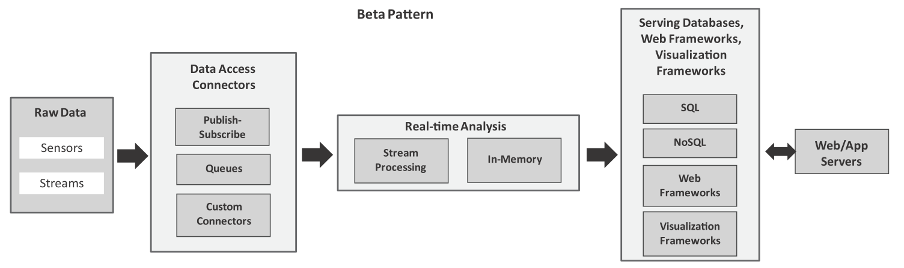
Analytics Patterns
Beta Pattern:
This pattern can be used for ingesting streaming data using publish-subscribe messaging frameworks, queues and custom connectors. For real-time analysis, we can use stream processing frameworks (such as Storm) or in-memory processing frameworks (such as Spark).

Slide 24
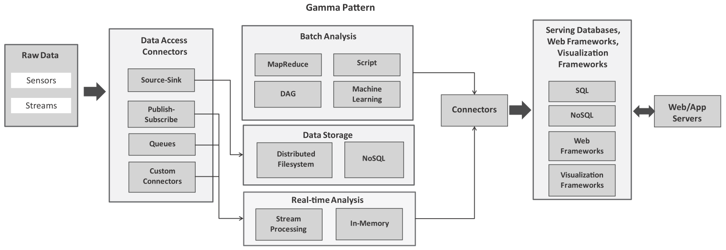
Analytics Patterns
Gamma Pattern:
This pattern is meant for ingesting streaming data into a big data stack and analyzing the data both in real-time and in batch modes.

Slide 25
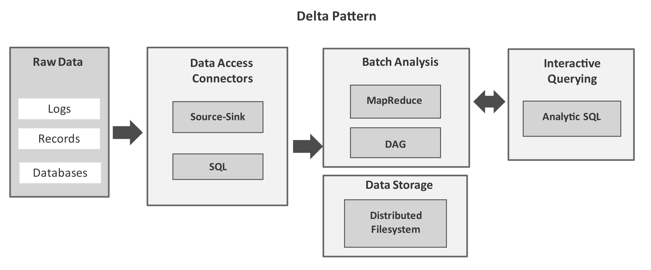
Analytics Patterns
Delta Pattern:
This pattern uses, source-sink connectors (such as Flume) or SQL connectors (such as Sqoop) to ingest bulk data into the big data stack. After the data is moved to a distributed ﬁlesystem, you can use interactive querying frameworks (such as Hive or Spark SQL) for querying data with SQL-like queries in an interactive mode.

Slide 26
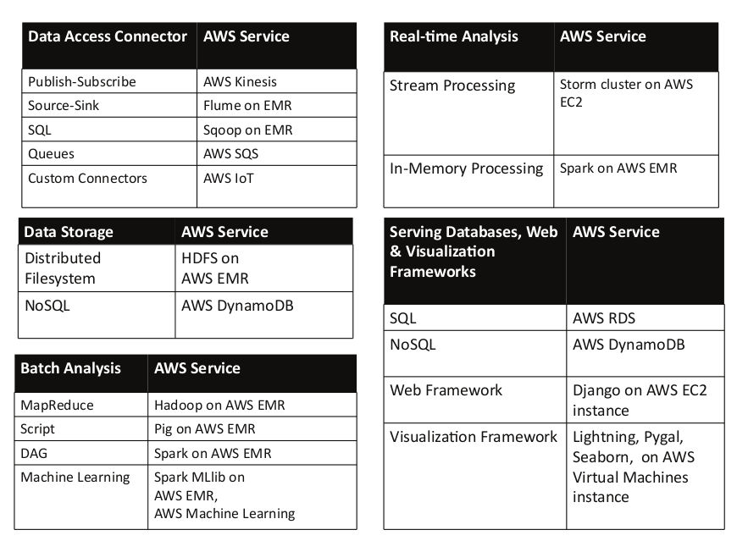
Mapping of blocks in analytics patterns to AWS services

Slide 27
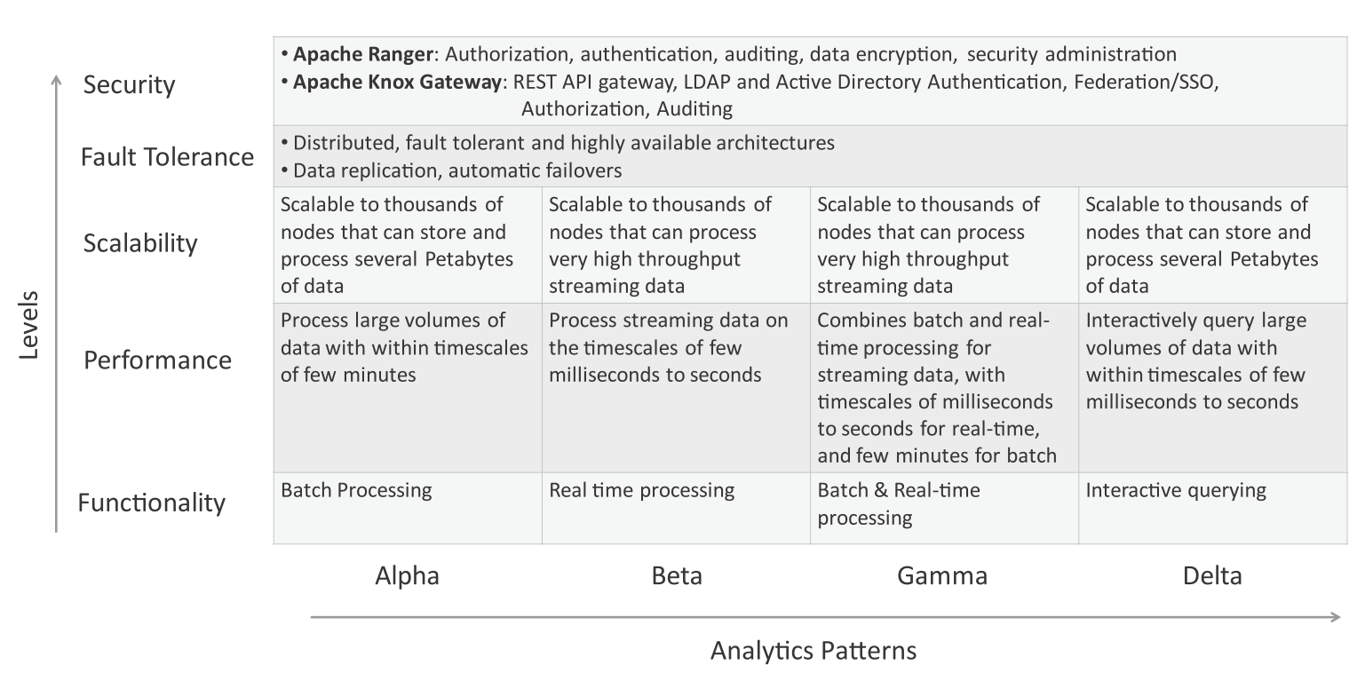
Complexity Levels for Analytics Patterns

